Slide 1
Recruitment Portal
(RP)
June, 2026

Slide 2
3. About Recruitment Portal:
Pursuant to the need for recruitment of teachers at various positions and levels at BTSC .A software has to be developed for this purpose.
The software will be Designed and developed in accordance with the guidelines by BTSC.
The software will be capable to:
Receive applications and recruitment fee online;
Scrutinise the application and send query to the applicant, if required;
Prepare the merit-list and merit-marks in accordance with the recommendations of the district-level committee;
The Managing committee will be able to finalise the district lists and then issue appointment letters to the candidates;

Slide 3
3A. Implementation Methodology:
Design and approval of Functional requirement Specification(FRS) document;
Design and approval of process and flow of the application;
Finalisation of fields and validation of Application form;
Integration of 3rd-party services such as Aadhaar, SMS, Email, Payment gateway, any other if required.
UAT and Application Security audit;
Hosting at State Data Centre;
Go Live of application

Slide 4
3B. Dependencies:
Sr. no. | Entity | Purpose | Minimum Expected time
1. | Adhaar authority | Integration with Aadhaar database to check deduplication | 1 week
2. | Bihar State Data Centre | Hosting of Software Application | 1 week
3. | Security Auditor | Audit of software application | 1 Week
4. | National Informatics Centre | Email service with SMTP relay server activation SMS gateway | 1 Month
5. | Payment Gateway | For receiving fee through online payment mode | 2 Weeks

Slide 5
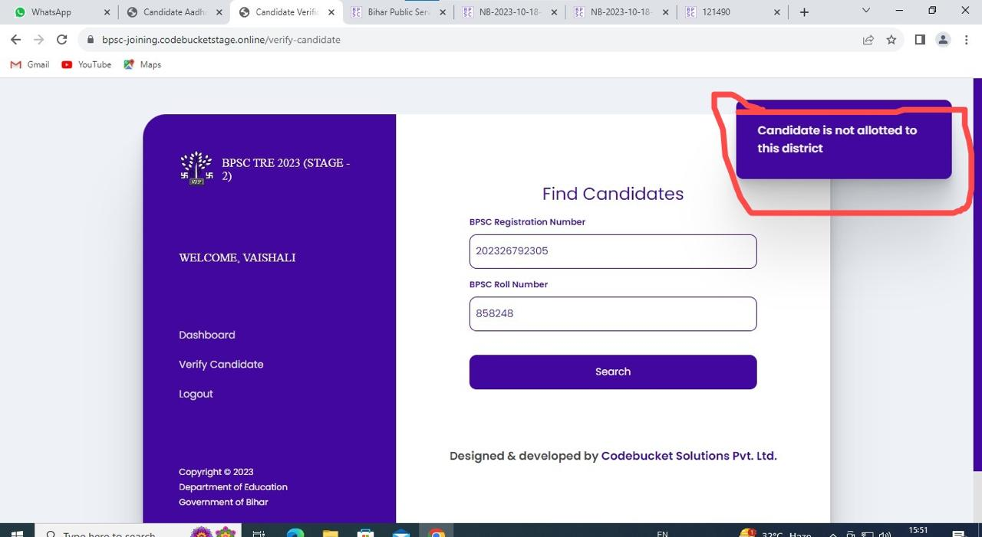

Slide 6
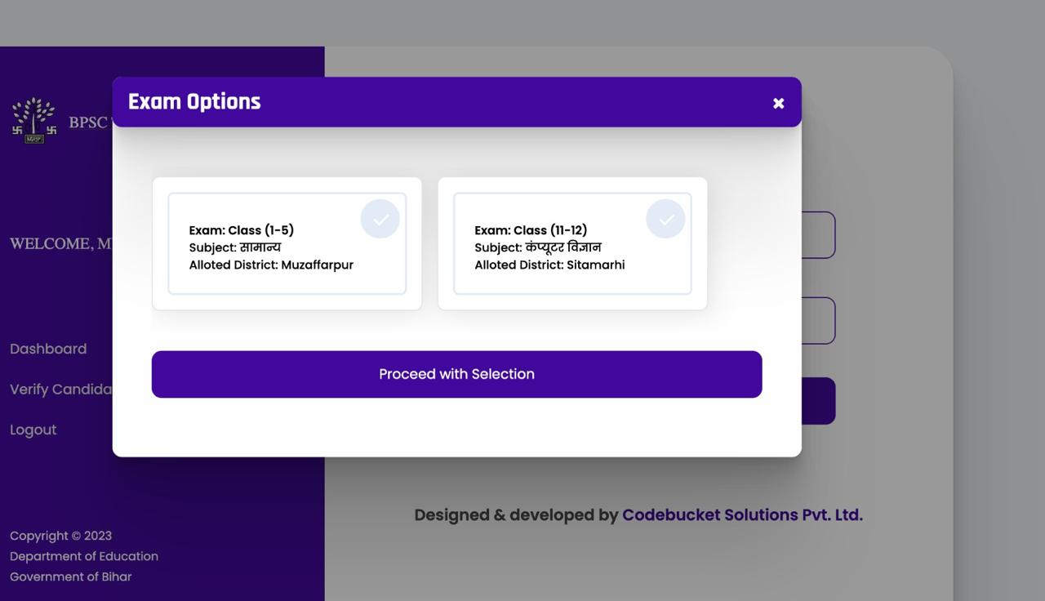

Slide 7
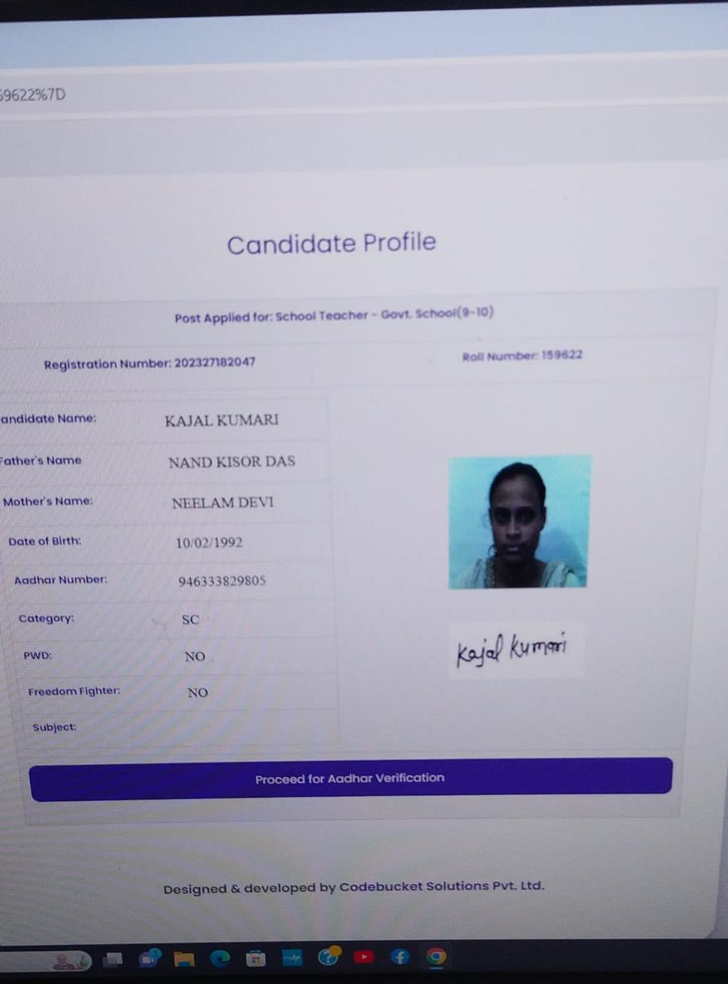

Slide 8
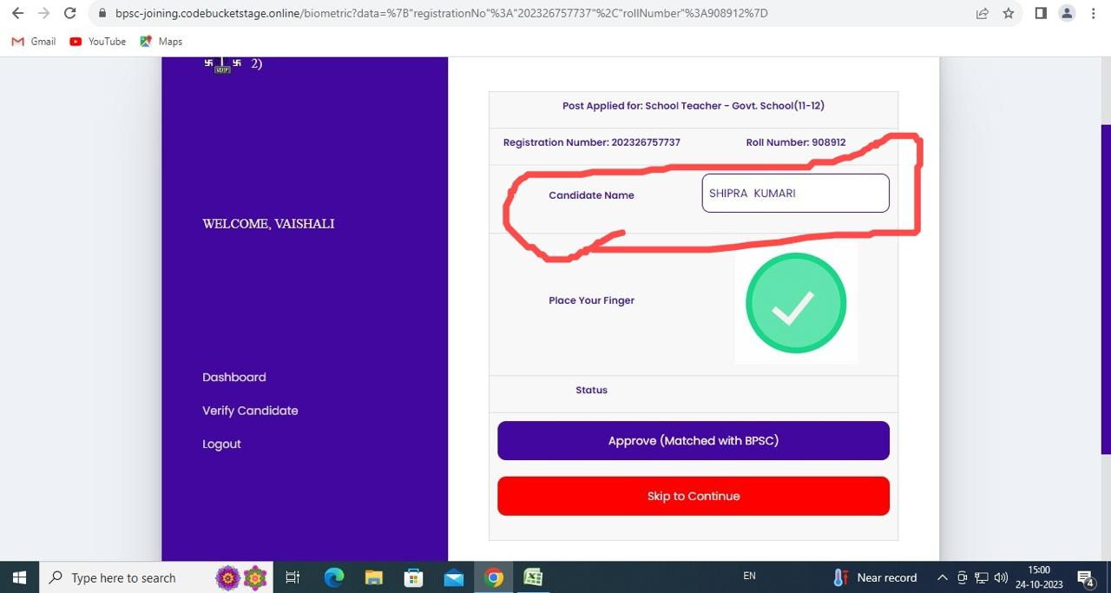

Slide 9
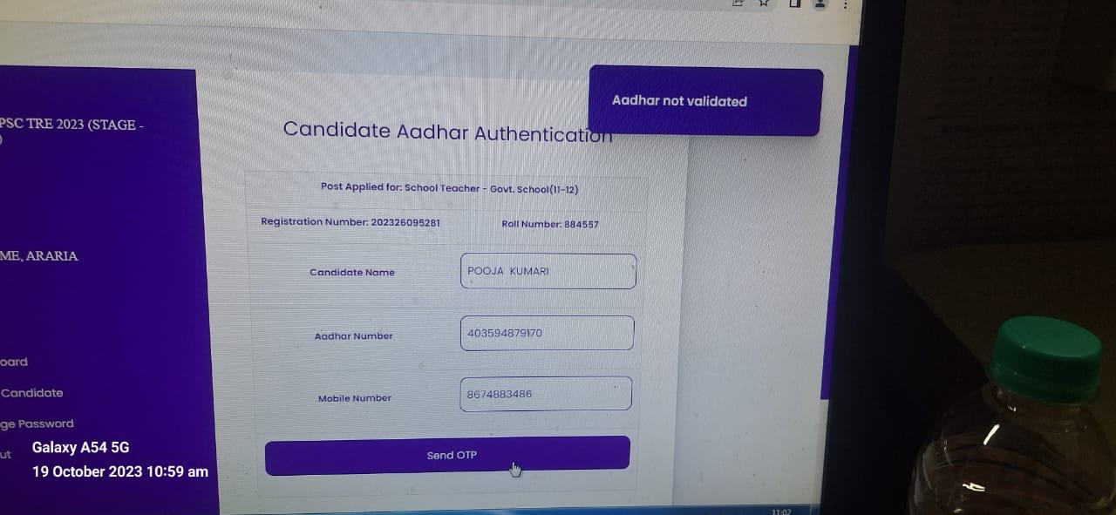

Slide 10
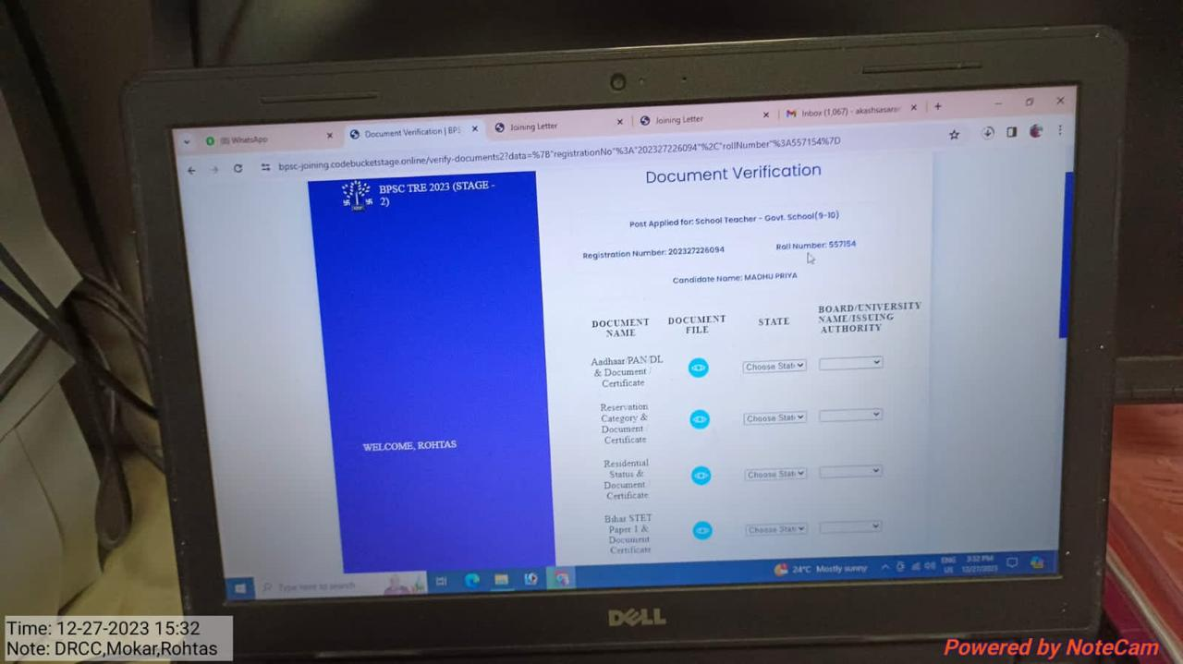

Slide 11
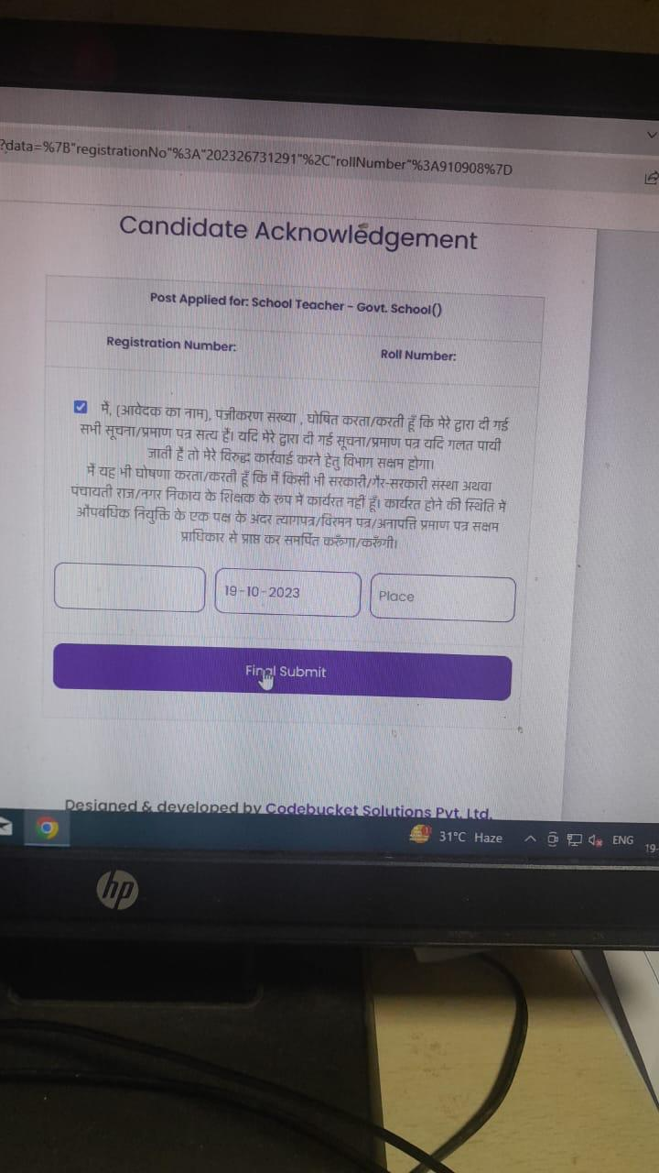

Slide 12
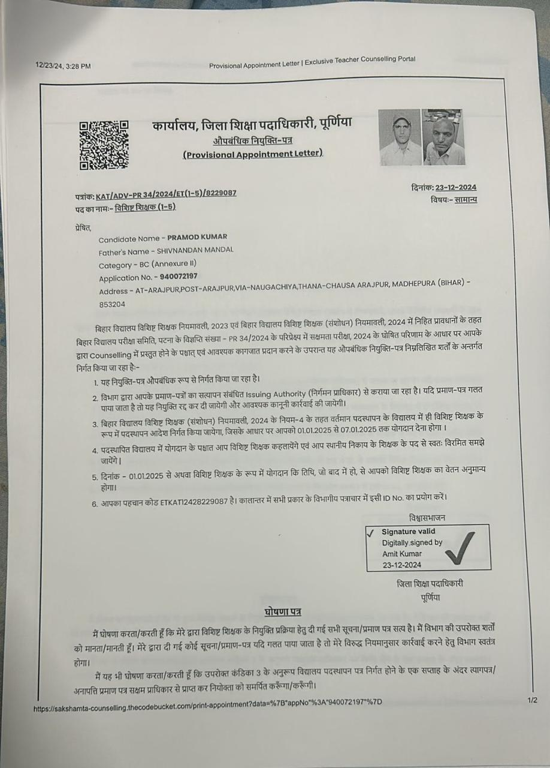

Slide 13
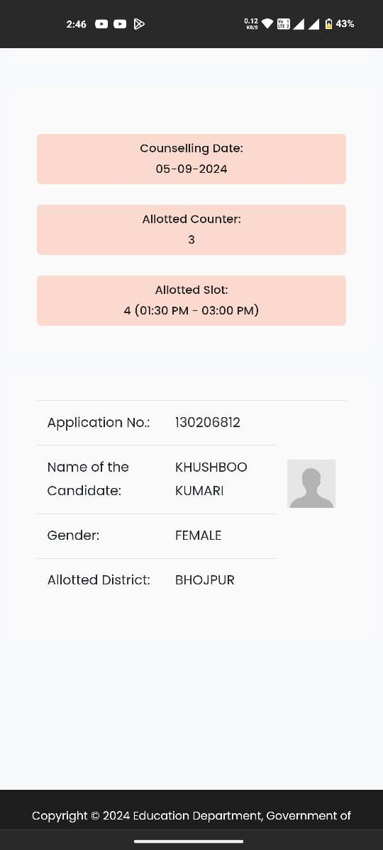

Slide 14
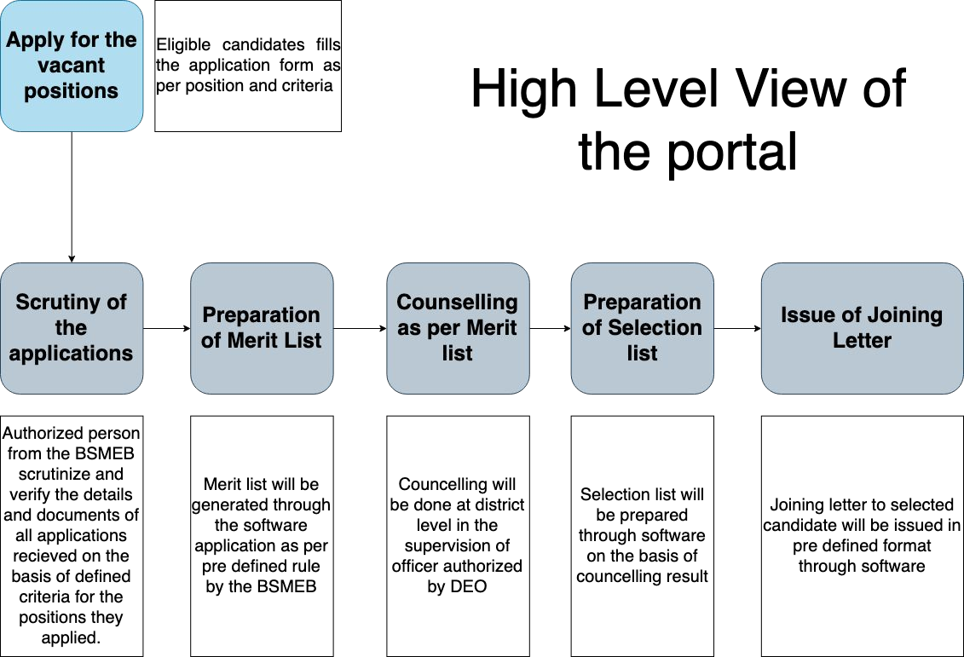
3C. High-Level view of application:

Slide 15
3E. Modules in application:
User Authentication Module: This module handles user registration, login, and password management.
Job Listing Module: This module allows you to post job openings, including job titles, descriptions, requirements, and other relevant details.
Application Form Module: This module enables candidates to submit their applications, including personal information, resumes, cover letters, and responses to specific questions related to the job.
Admin Panel Module: This module provides administrative access to manage various aspects of the recruitment portal, such as user roles, job listings, and applicant data.
Application Management Module: Within the admin panel, this module allows administrators to review and manage received job applications. It should include features for filtering, sorting, and tracking application statuses.
User Roles and Permissions Module: This module defines user roles, such as administrators, recruiters, and applicants, and controls what actions each role can perform within the system.
Notification Module: This module handles notifications to applicants and recruiters, notifying them of application updates, interview schedules, and other relevant events.
Search and Filter Module: A module that helps users, including administrators, search and filter job listings and applications based on various criteria.
Communication Module: This module supports communication between applicants and recruiters, allowing for messages and scheduling of interviews.
Reporting and Analytics Module: This module provides insights into the recruitment process, including data on the number of applicants, job listing performance, and diversity metrics.
Integration Module: If you want to integrate with external systems, such as HR management software, this module handles those integrations.
File Management Module: Manages the storage and retrieval of documents, such as resumes and cover letters, associated with applications.
Feedback and Evaluation Module: This module allows for feedback and evaluation of applicants by recruiters and hiring managers.

Slide 16

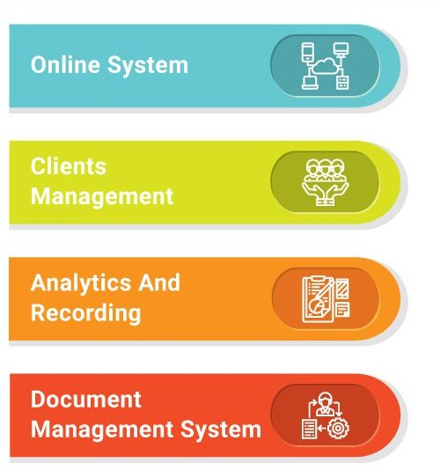
4. Delivery Model:
Web application-1,
Integrations with 3rd party services,
Role-based access,
Scalable model and services,
Secured using Blockchain Technology, if required.

Slide 17
Thank you

